Slide 1
Introduction

Slide 2

Outline
The System Development Life Cycle
Major Development Methodologies
Major Team Roles

Slide 3
Key Ideas
Many failed systems were abandoned because analysts tried to build wonderful systems without understanding the organization.
The primarily goal is to create value for the organization.

Slide 4
Key Ideas
The systems analyst is a key person analyzing the business, identifying opportunities for improvement, and designing information systems to implement these ideas.
It is important to understand and develop through practice the skills needed to successfully design and implement new information systems.

Slide 5
THE SYSTEMS DEVELOPMENT LIFE CYCLE

Slide 6

Major Attributes of the Lifecycle
The project --
  Moves systematically through phases where each phase has a standard set of outputs
  Produces project deliverables
  Uses deliverables in implementation
  Results in actual information system
  Uses gradual refinement

Slide 7
Project Phases
Planning (Why build the system?)
Analysis (Who, what, when, where will the system be?)
Design (How will the system work?)
Implementation (System delivery)

Slide 8
Planning
Identifying business value
Analyze feasibility
Develop work plan
Staff the project
Control and direct project

Slide 9
Analysis
Analysis
Information gathering
Process modeling
Data modeling

Slide 10
Design
Algorithm Design
Architectural design (hardware, software, network infrastructure)
Interface design
Database and file design

Slide 11
Implementation
Construction
  Build & Test
Installation
  Direct cutover
  Parallel conversion
  Phased conversion

Slide 12
Processes and Deliverables
Process
Product
Project Plan
System Proposal
System
Specification
New System and
Maintenance Plan
Planning
Analysis
Design
Implementation

Slide 13
SYSTEM DEVELOPMENT METHODOLOGIES

Slide 14
What Is a Methodology?
A formalized approach or series of steps

Slide 15
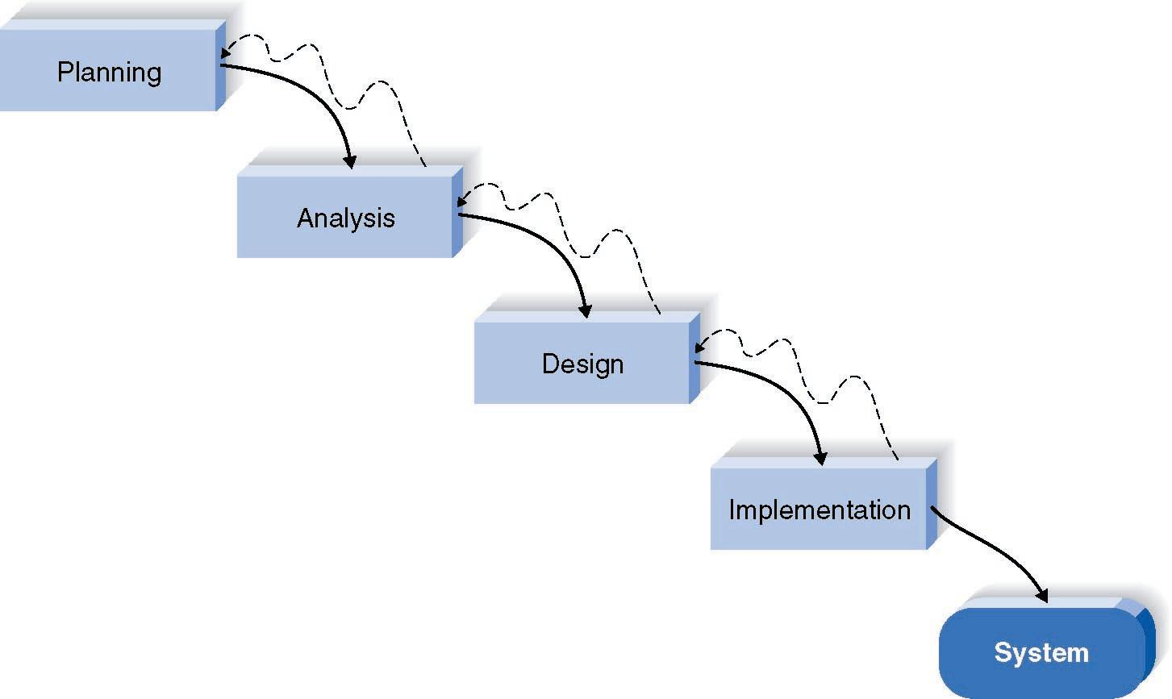
Waterfall Development Method

Slide 16
Pros and Cons of the Waterfall Method
Adv.
DisA.
Identifies systems
requirements long
before programming
begins
Design must be
specified on paper
before programming
begins
Long time between
system proposal and
delivery of new
system

Slide 17
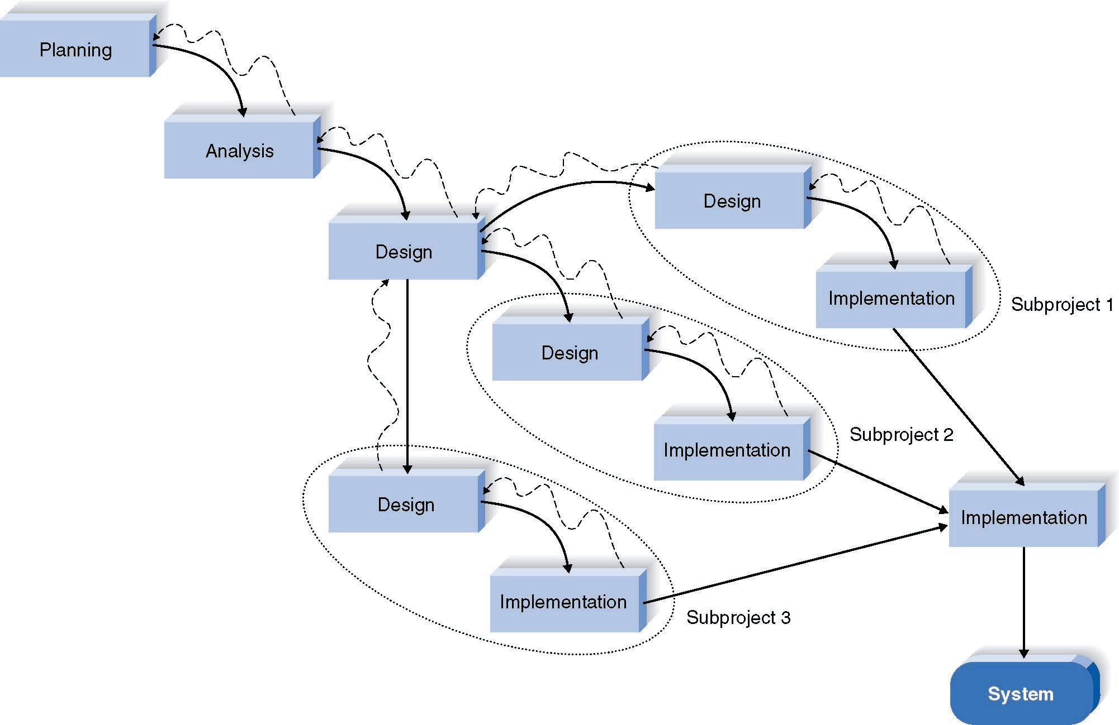
Parallel Development Method

Slide 18
Pros and Cons of Parallel Development
Adv.
DisA.
Reduces Scheduled
Time
Still Uses Paper
Documents
Less Chance of
Rework
Sub-projects May Be
Difficult to Integrate

Slide 19
Three RAD Categories
Phased development
  A series of versions
Prototyping
  System prototyping
Throw-away prototyping
  Design prototyping

Slide 20
Phased Development
Planning
Analysis
Version 1
  Analysis, Design, Implementation
Version 2
  Analysis, Design, Implementation
  So on.

Slide 21
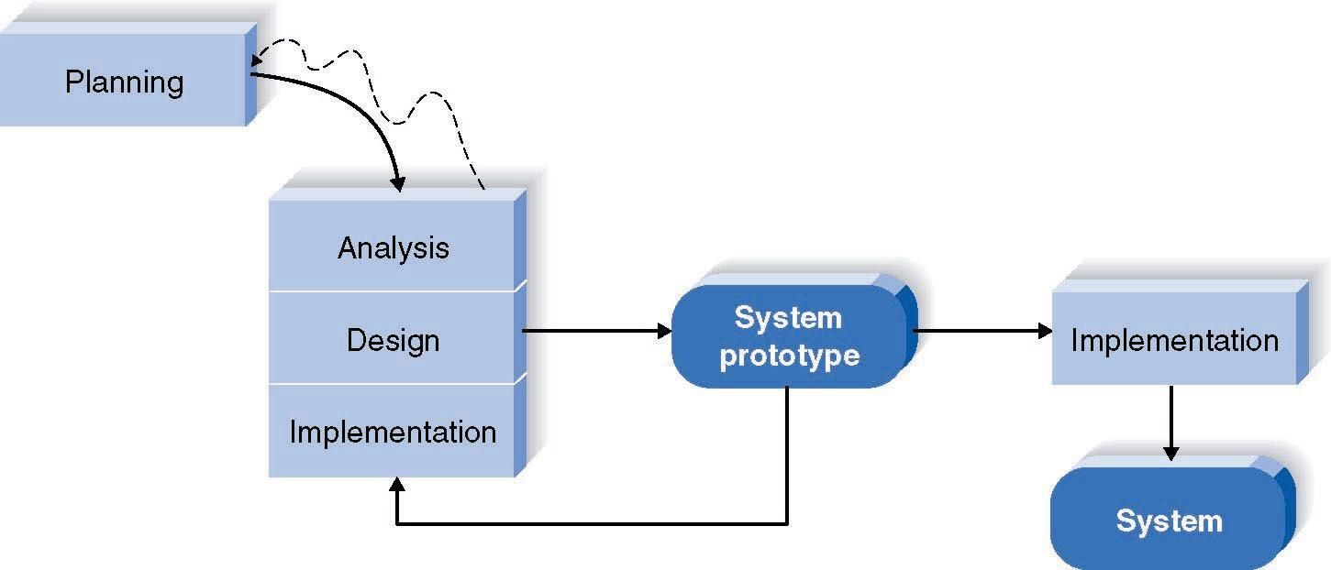
How Prototyping Works

Slide 22
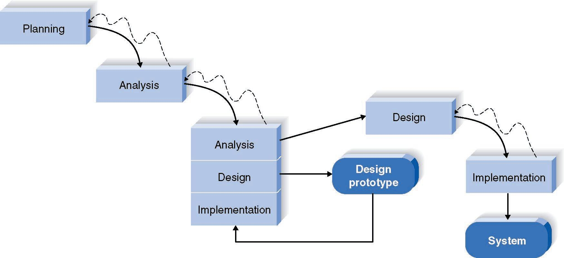
Throwaway Prototyping

Slide 23
Criteria for Selecting the Appropriate Methodology
Clear user requirements
Familiar technology
Complexity
Reliability
Short Time schedule

Slide 24
TEAM ROLES AND SKILLS

Slide 25
Information Systems Roles
Business analyst
System analyst
Infrastructure analyst
Change management analyst
Project manager

Slide 26
Summary
The Systems Development Lifecycle consists of four stages: Planning, Analysis, Design, and Implementation
There are five major development methodologies: the waterfall method, the parallel development method, the phased development method, system prototyping and design prototyping.
There are five major team roles: business analyst, systems analyst, infrastructure analyst, change management analyst and project manager.

